Slide 1


Titolo presentazione sottotitolo
Implicit Methods
for the Eikonal Equation
Milano, XX mese 20XX
Advanced Programming for Scientific Computing
a.a. 2023-24
Francesco Fainello, Francesca Venturi

Slide 2
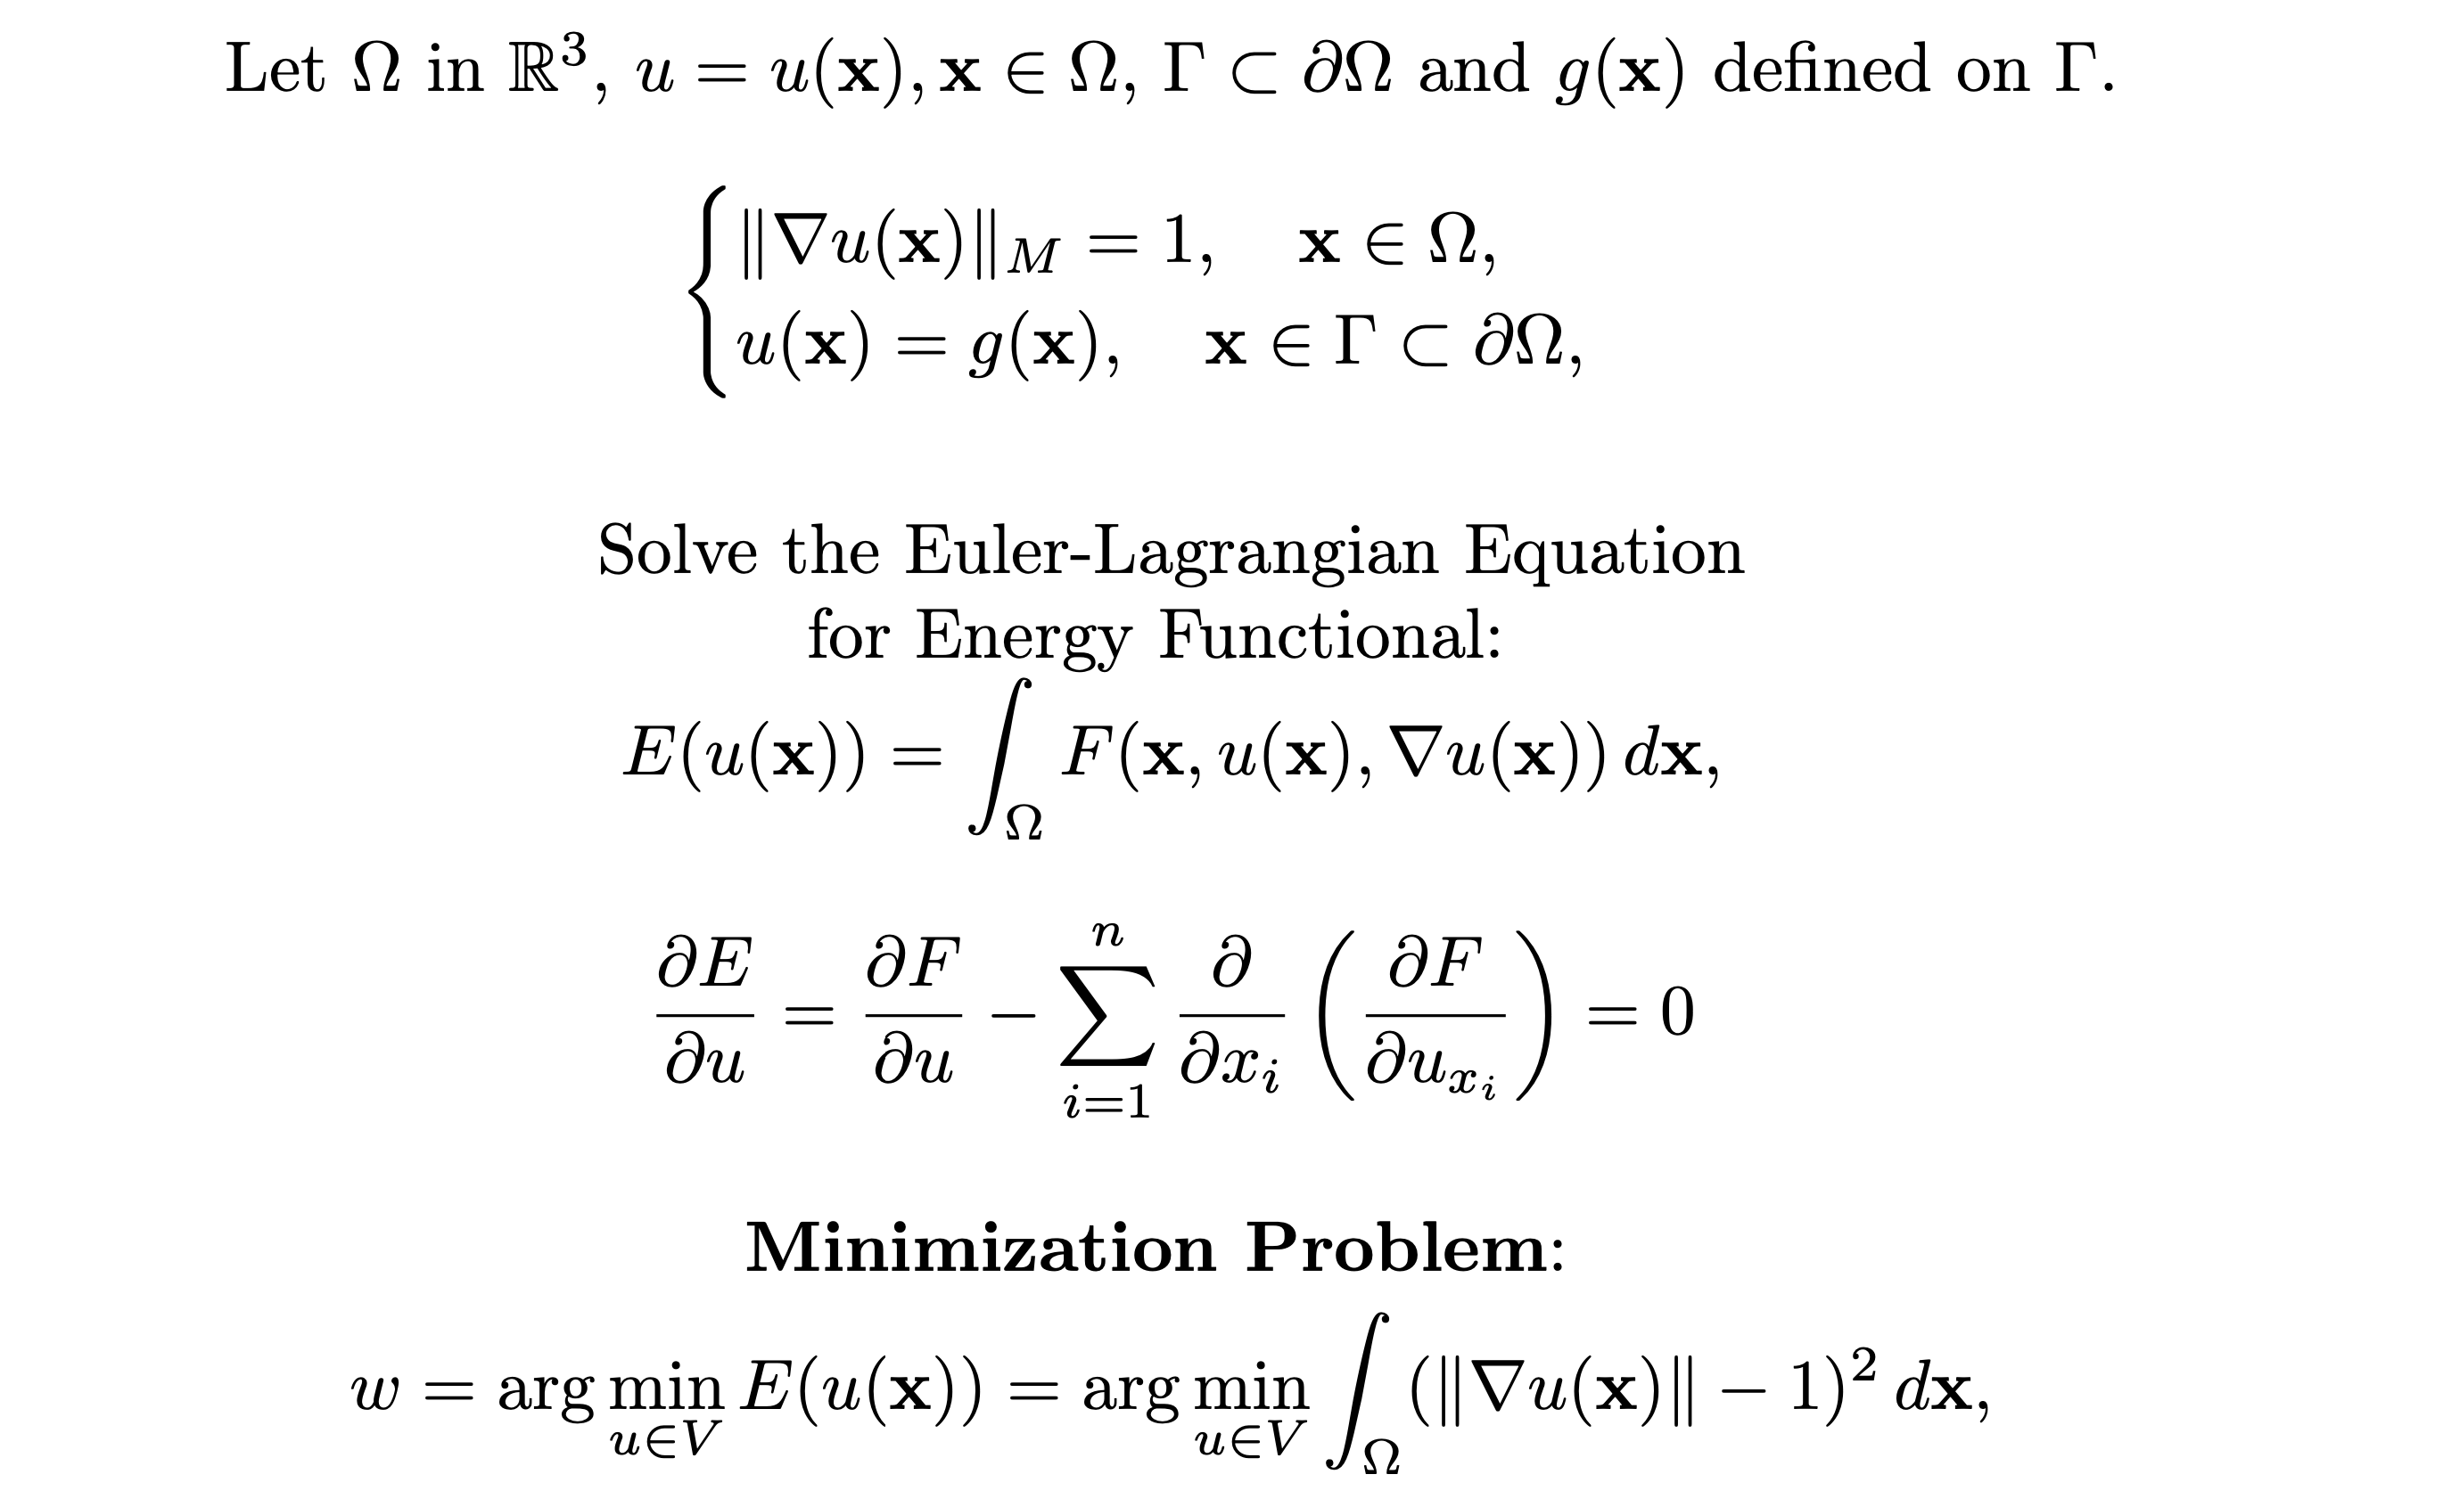
Problem Statement – The Eikonal Equation

Slide 3
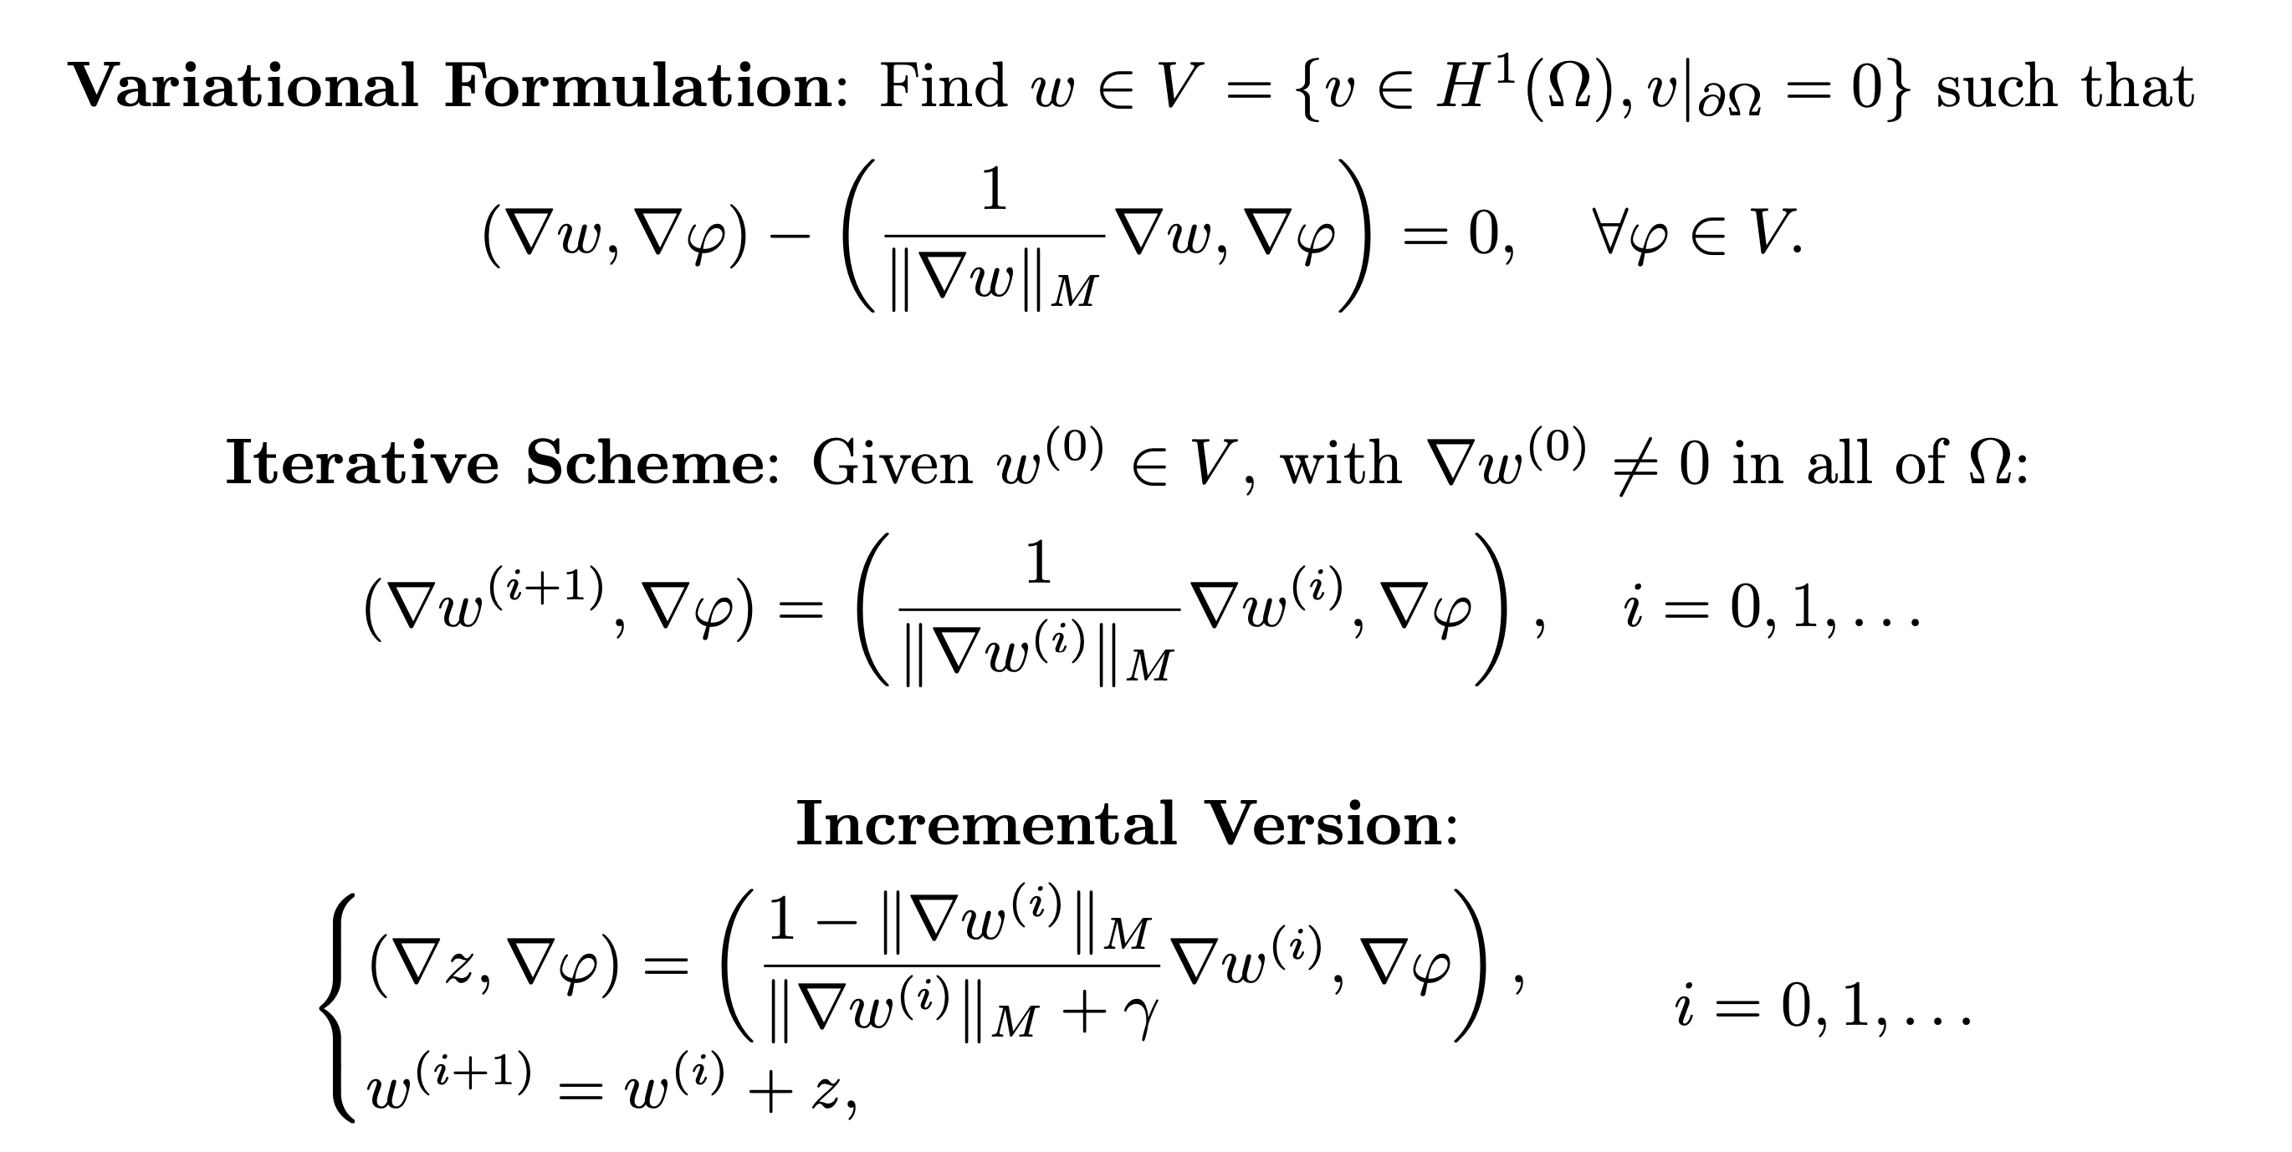
Methods of Laplacian Interations

Slide 4
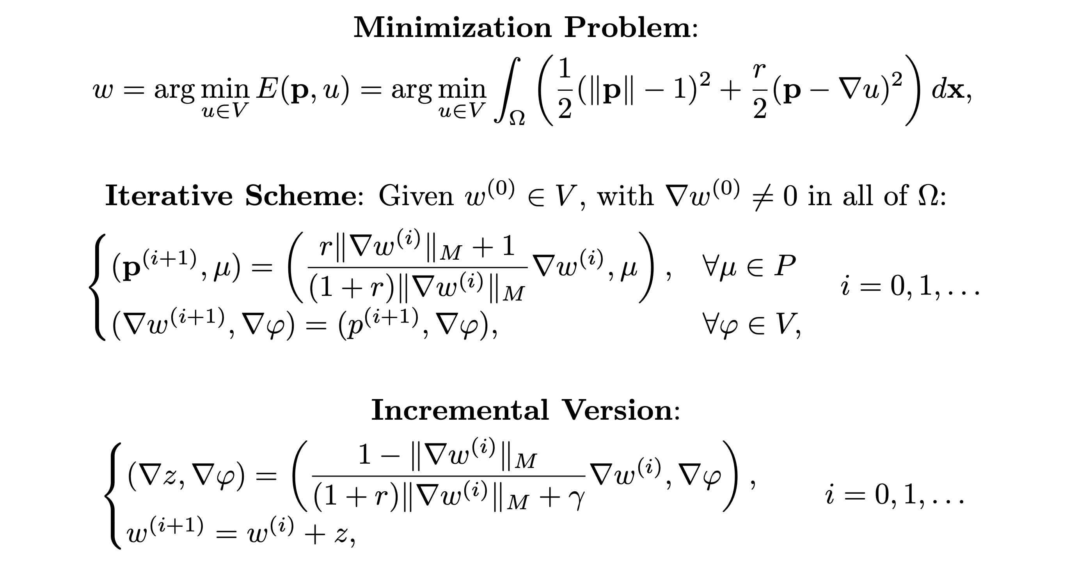
Relaxation of Laplacian Interations

Slide 5
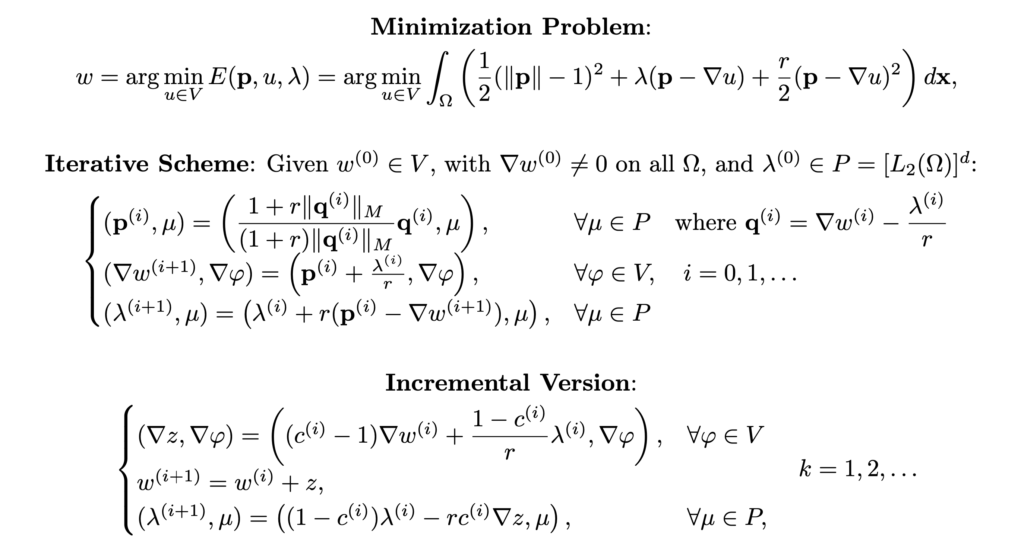
Alternating Direction Method of Lagrange Multipliers

Slide 6
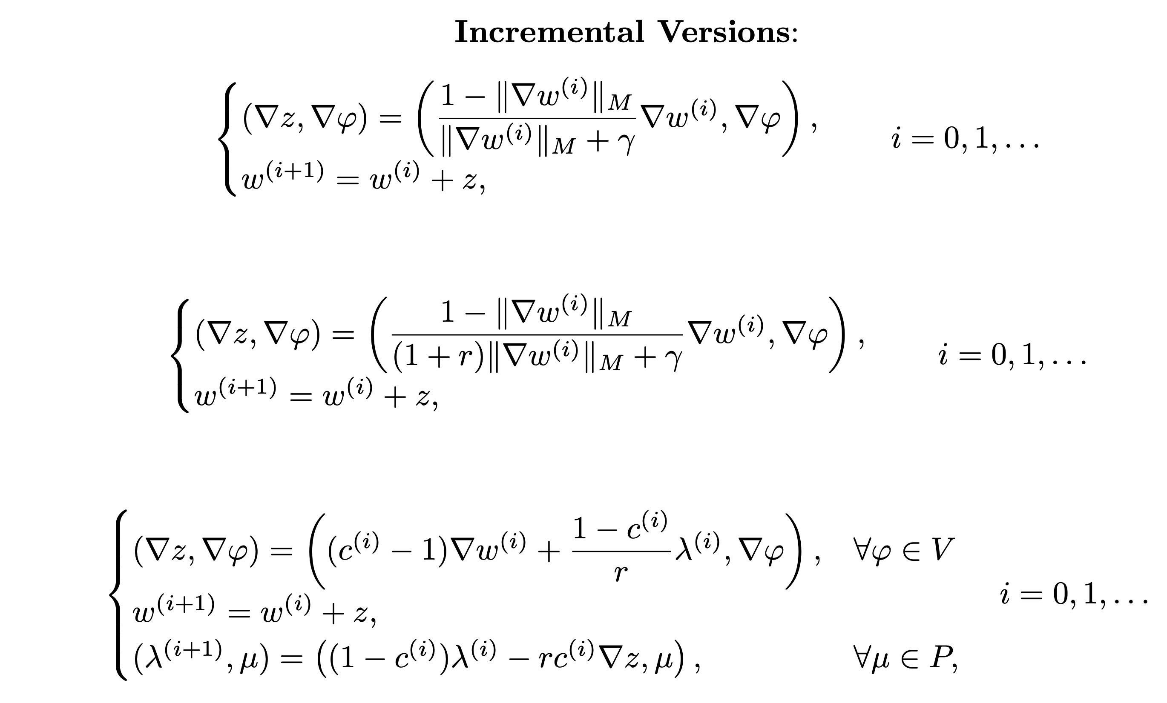
Differences in Incremental Versions

Slide 7
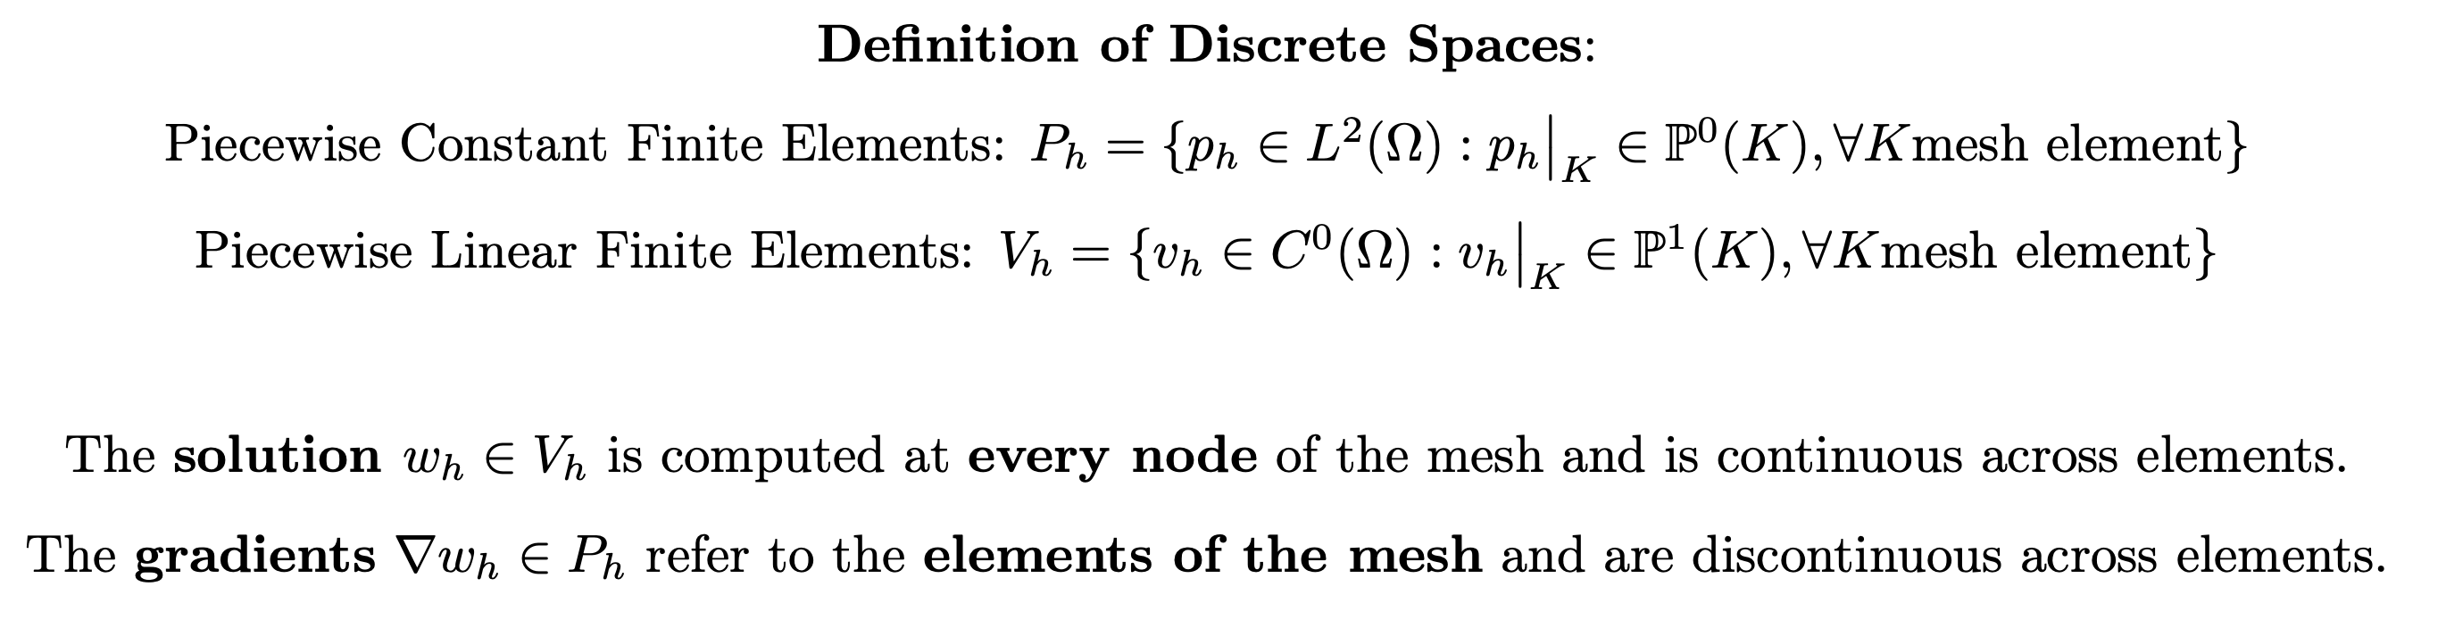
Towards Discretization

Slide 8
Eikonal Equation – Inheritance Structure
EikonalEquation
StandardEikonal
PenaltyEikonal
LagrangianEikonal

Slide 9
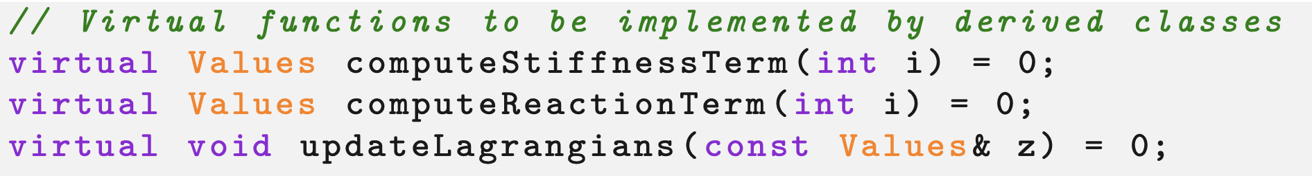
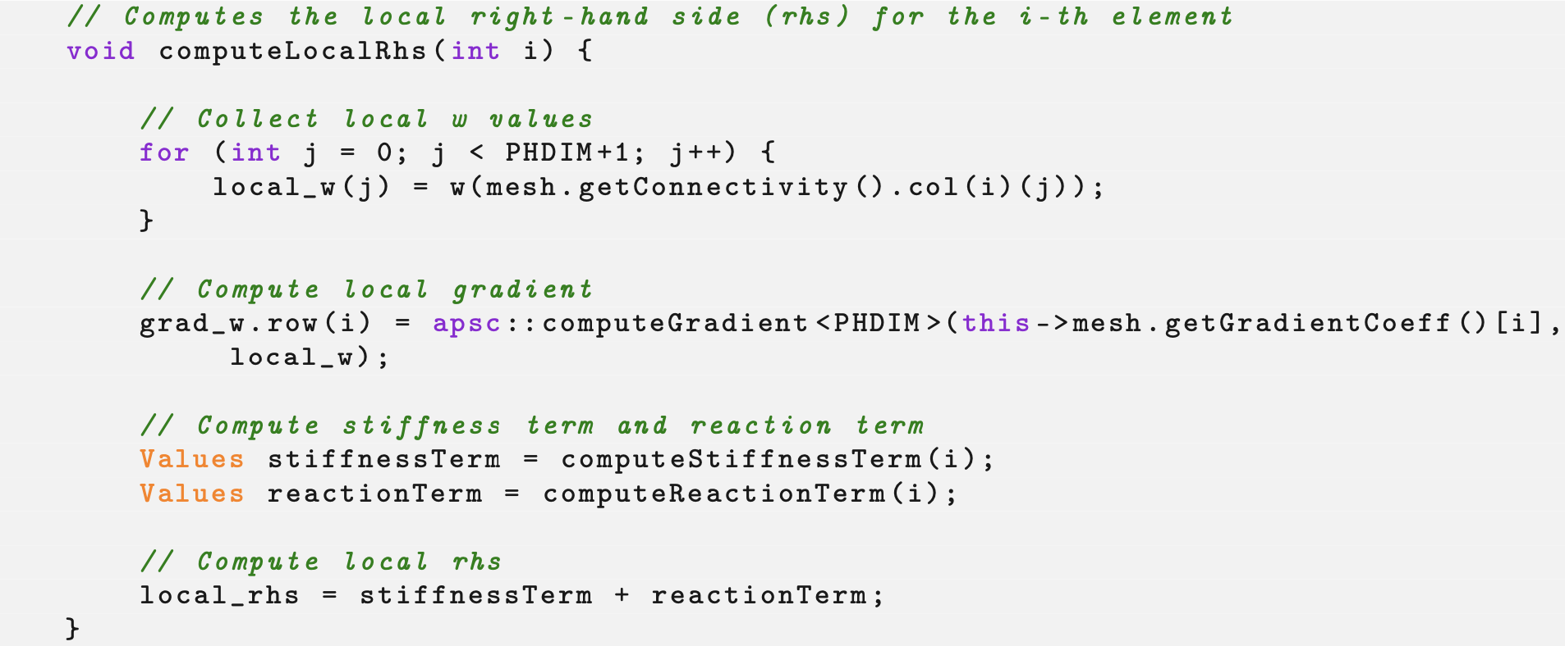
EikonalEquation
Abstract Parent Class
EikonalEquation
StandardEikonal
LagrangianEikonal
PenaltyEikonal

Slide 10
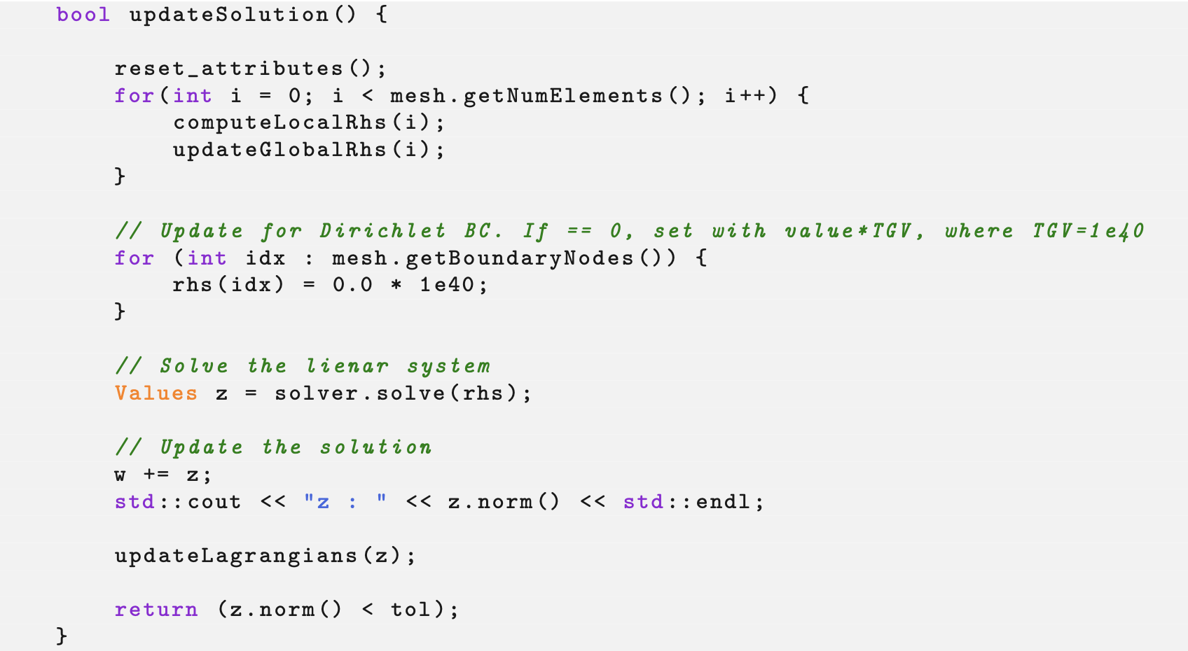
EikonalEquation
Abstract Parent Class
EikonalEquation
StandardEikonal
LagrangianEikonal
PenaltyEikonal

Slide 11
Eikonal Equation – Inheritance Structure
EikonalEquation
List the methods with lstlisting here
StandardEikonal
PenaltyEikonal
LagrangianEikonal

Slide 12
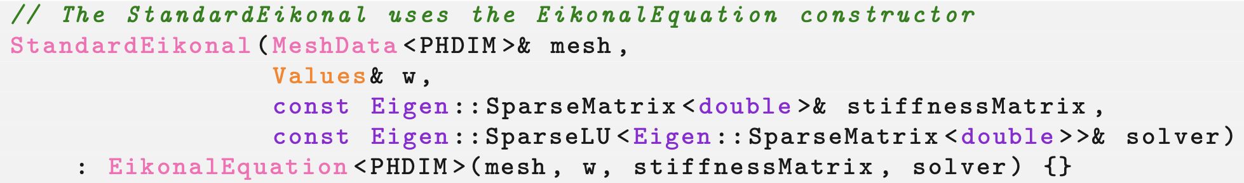
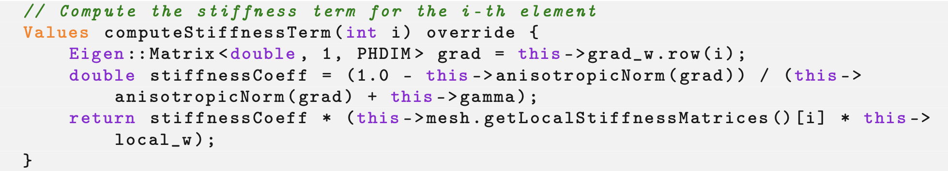
StandardEikonal
EikonalEquation
StandardEikonal
LagrangianEikonal
PenaltyEikonal

Slide 13
Eikonal Equation – Inheritance Structure
EikonalEquation
List the methods with lstlisting here
StandardEikonal
PenaltyEikonal
LagrangianEikonal
ComputeStiffnessTerm

Slide 14
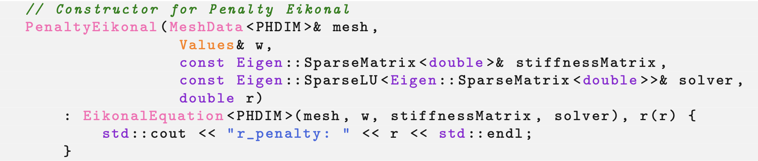
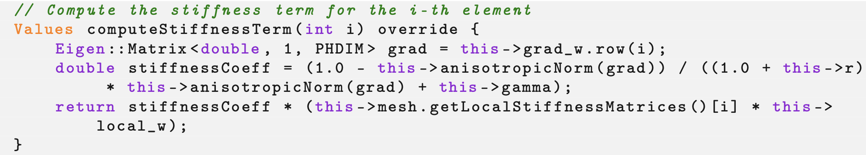
PenaltyEikonal
EikonalEquation
List the methods with lstlisting here
PenaltyEikonal
StandardEikonal
LagrangianEikonal
ComputeStiffnessTerm

Slide 15
Eikonal Equation – Inheritance Structure
EikonalEquation
List the methods with lstlisting here
StandardEikonal
PenaltyEikonal
LagrangianEikonal
ComputeStiffnessTerm
ComputeStiffnessTerm

Slide 16
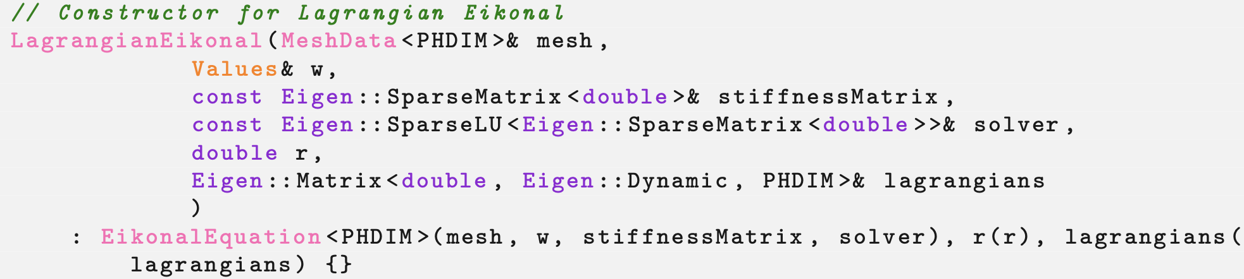
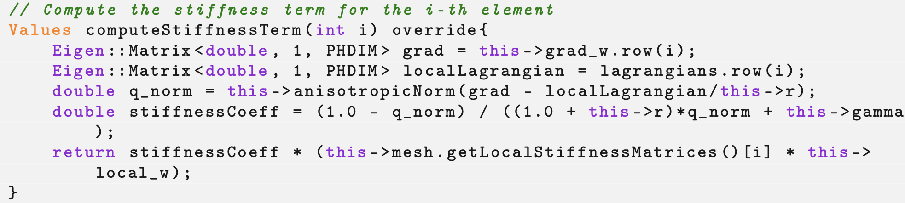
LagrangianEikonal
EikonalEquation
List the methods with lstlisting here
LagrangianEikonal
StandardEikonal
ComputeStiffnessTerm
PenaltyEikonal
ComputeStiffnessTerm

Slide 17
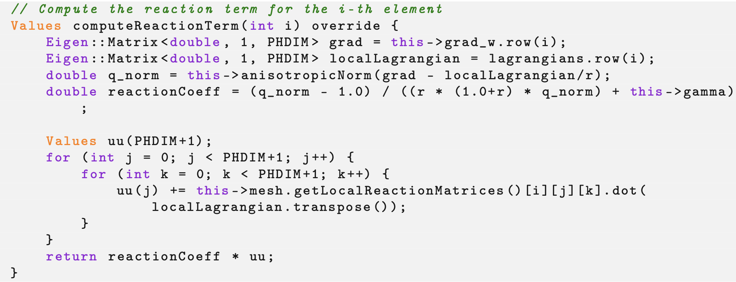
LagrangianEikonal
EikonalEquation
List the methods with lstlisting here
LagrangianEikonal
StandardEikonal
ComputeStiffnessTerm
PenaltyEikonal
ComputeStiffnessTerm

Slide 18
Workflow (main.cpp)
Read and upload the mesh.
Read the boundary nodes.
Set the initial condition by solving the heat equation.
Mesh Handling (MeshData.hpp)
Initial Solution (InitialConditions.hpp)
Variables SetUp (MeshData.hpp)
Iterative Solution (EikonalEquation.hpp)
Fill local variables.
Fill global variables.
Set boundary conditions.
Set the iterative method.
Update the solution.
Check convergence.

Slide 19
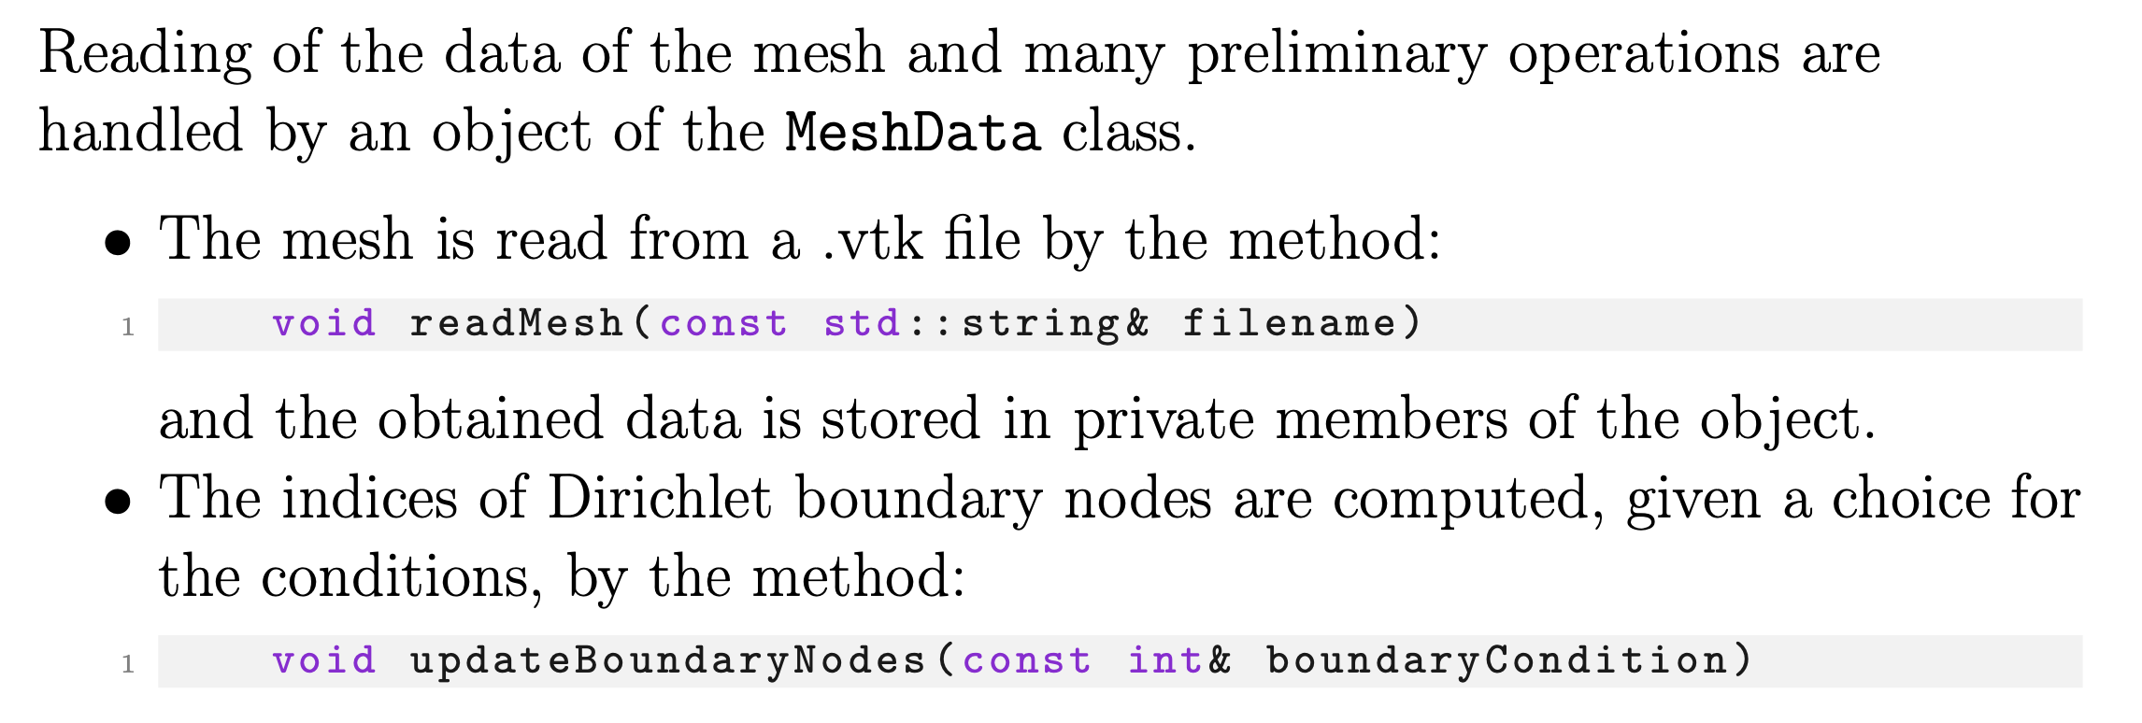
Mesh Handling

Slide 20
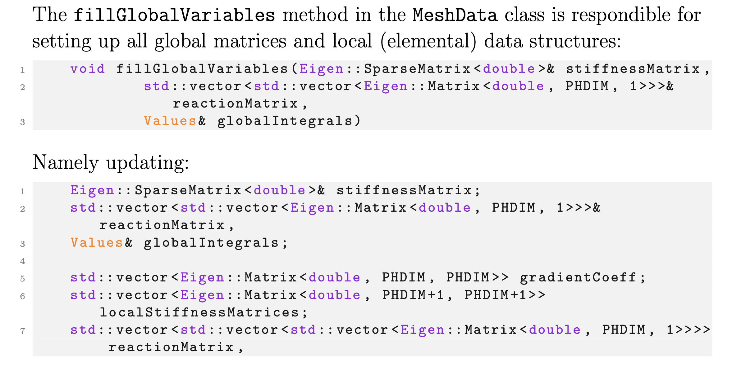
Global & Local Variables

Slide 21
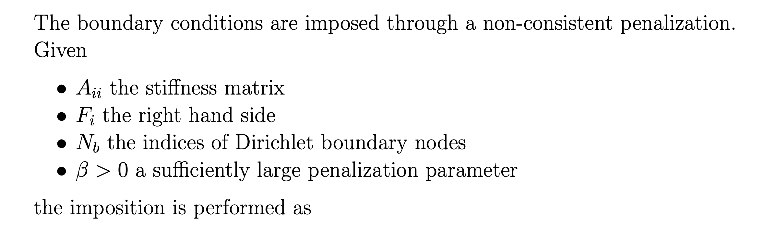
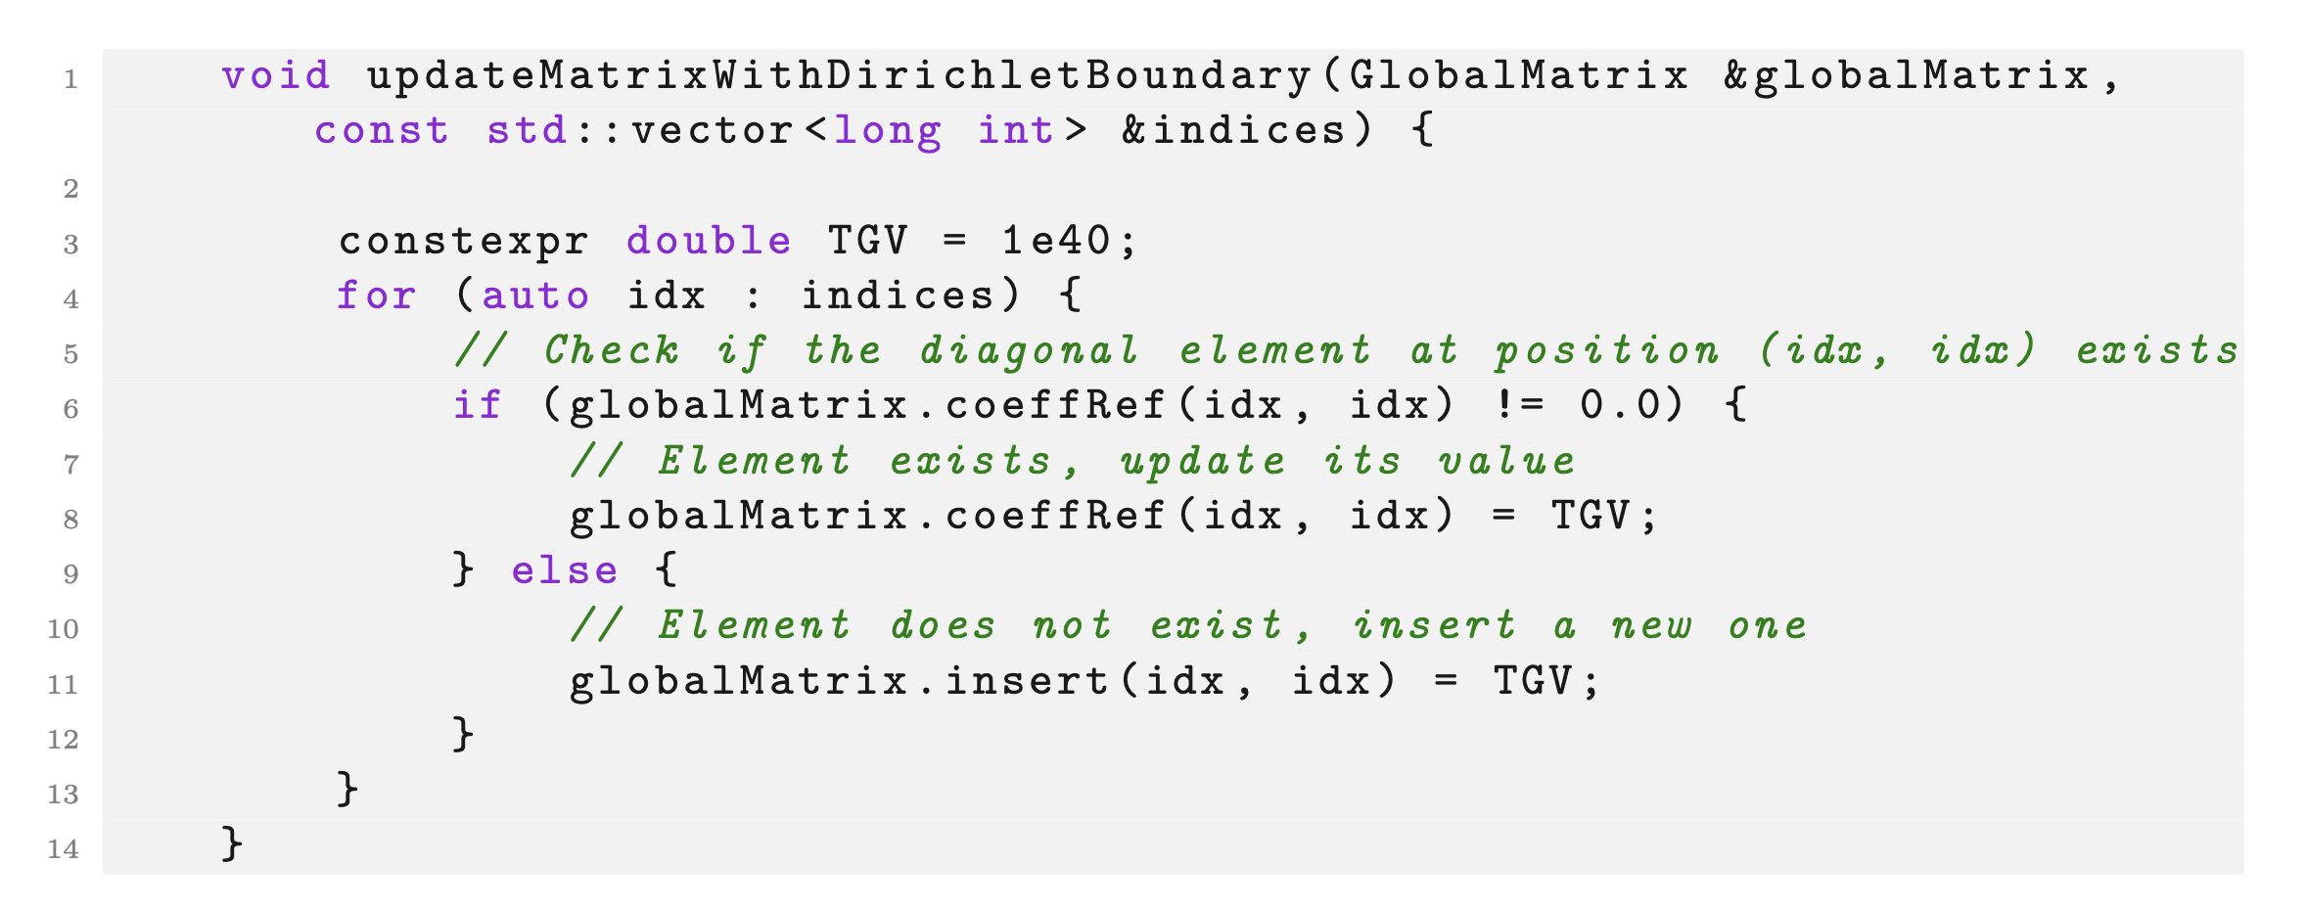
Boundary conditions

Slide 22
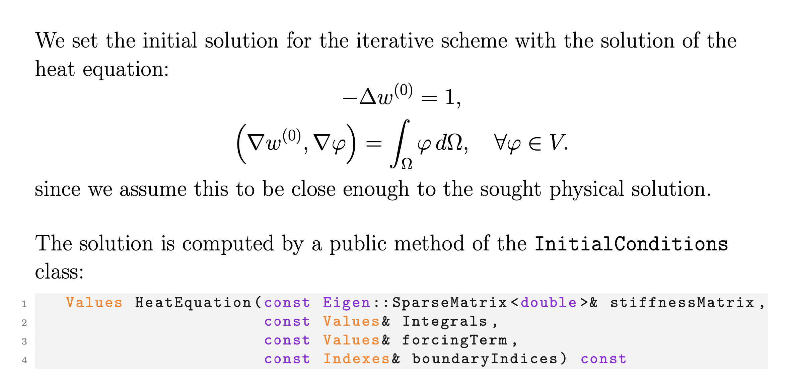
Initial conditions

Slide 23
Parallelization
Read input data and compute global/local matrices
Broadcast variables and initialize MeshData & EikonalEquation
Compute solution update
Check convergence and broadcast update
Compute RHS
Rank 0
Rank 0
Rank 0
Rank 0
Rank 0
Rank 1
Rank 1
Rank 1
Rank 2
Rank 2
Rank 2
…
…
…
Broadcast input info
Reduce rhs
Broadcast solution
Iterations

Slide 24
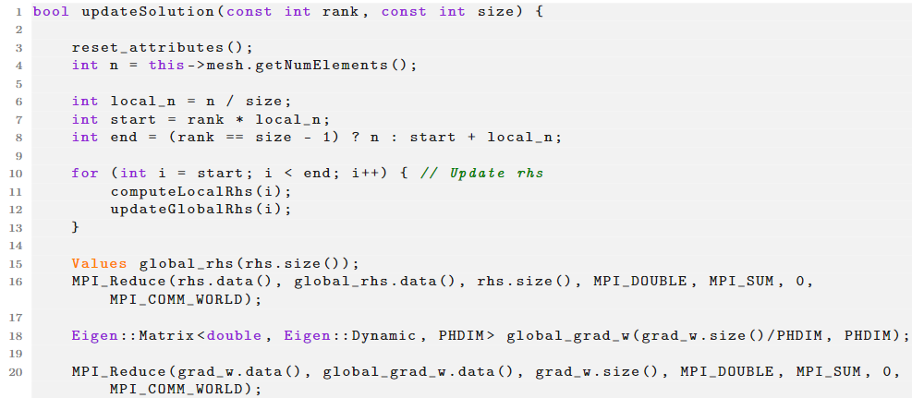
Parallelization

Slide 25
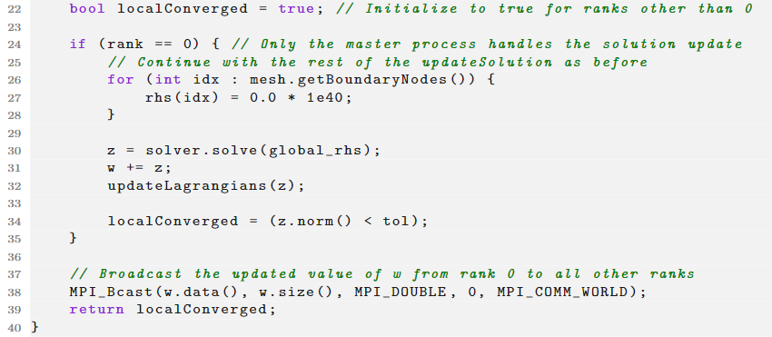
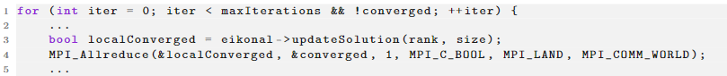
Parallelization
What about the main?

Slide 26
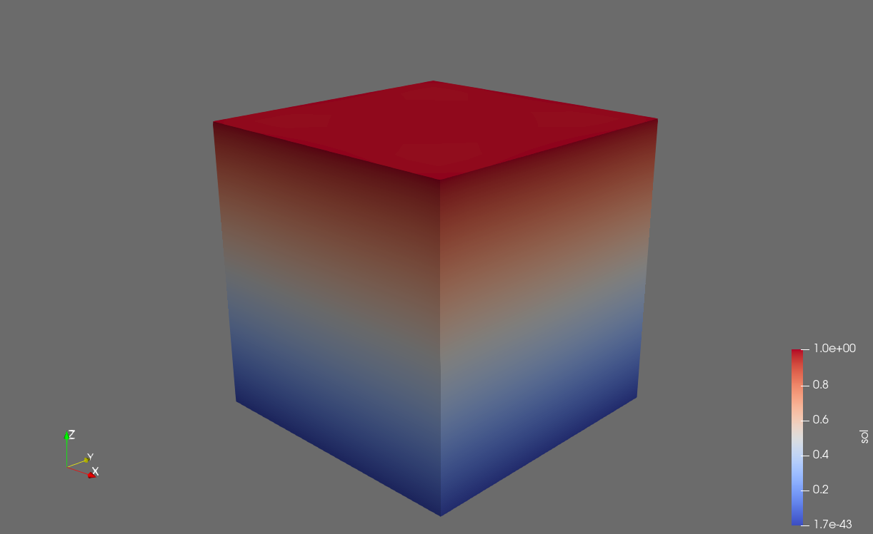
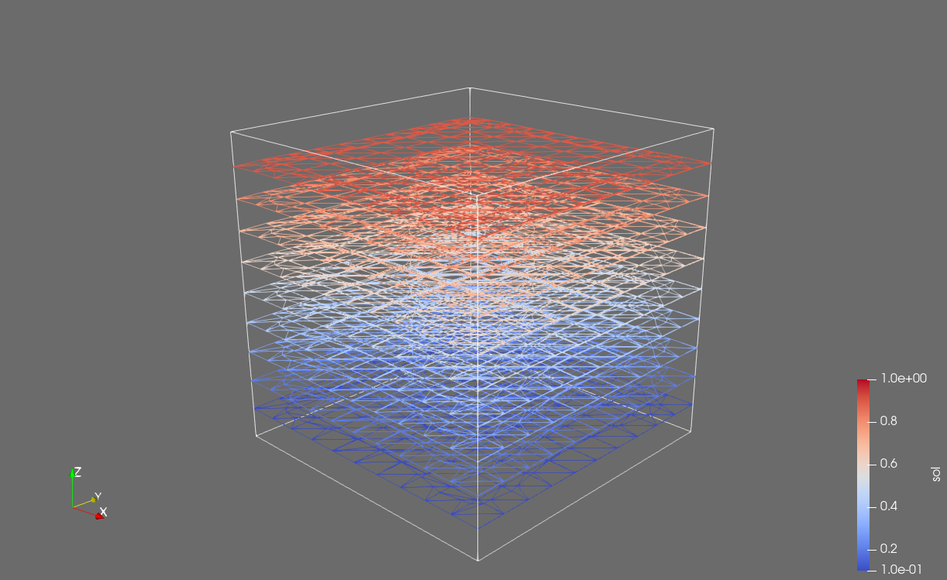
Results
Solution and contour plots for Dirichlet boundary conditions on the bottom face of the domain

Slide 27
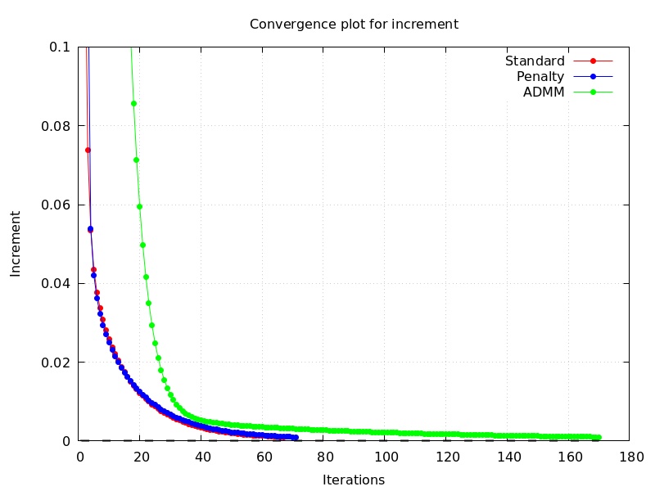
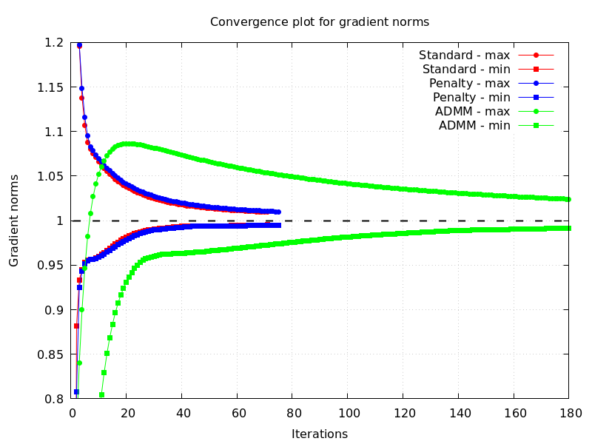
Results
Convergence of the incremental solution
(termination criterion)
Convergence of the gradient norms

Slide 28
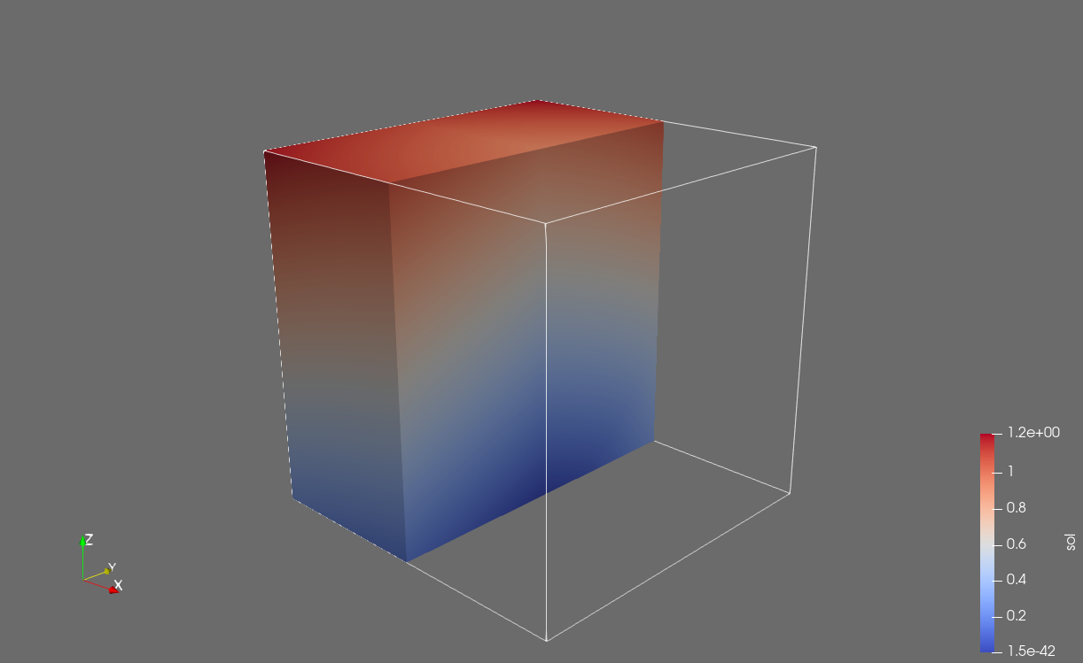
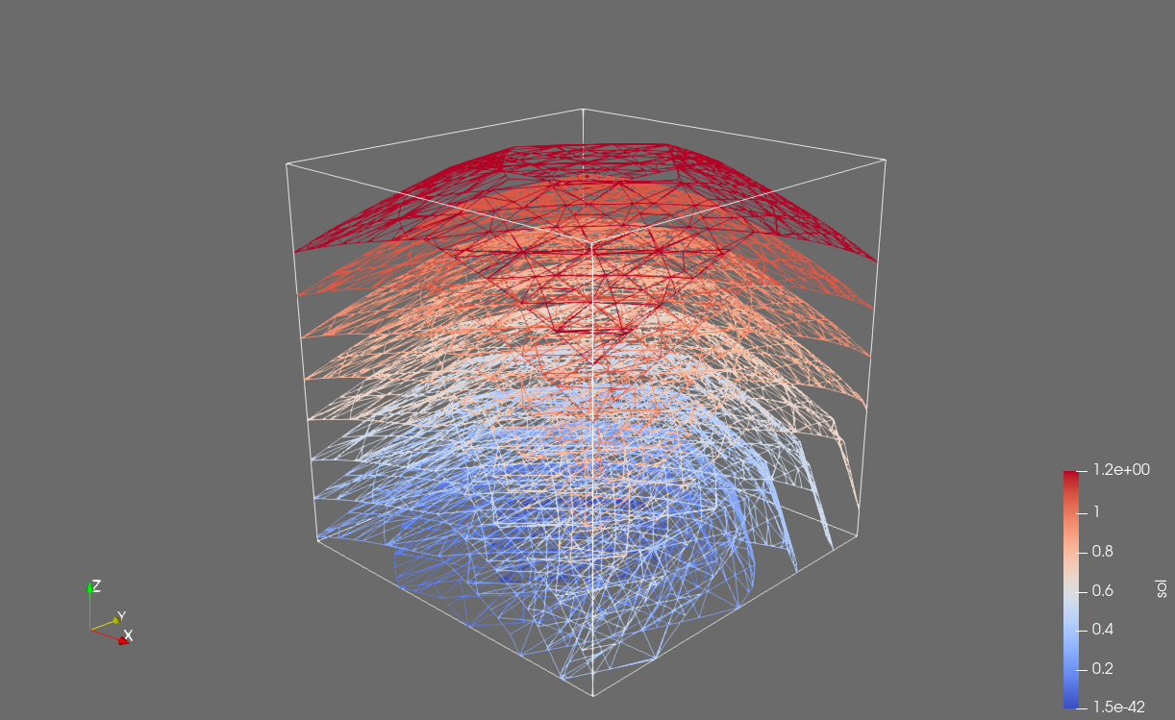
Results
Solution and contour plot for Dirichlet boundary conditions on the central node of the bottom face of the domain

Slide 29
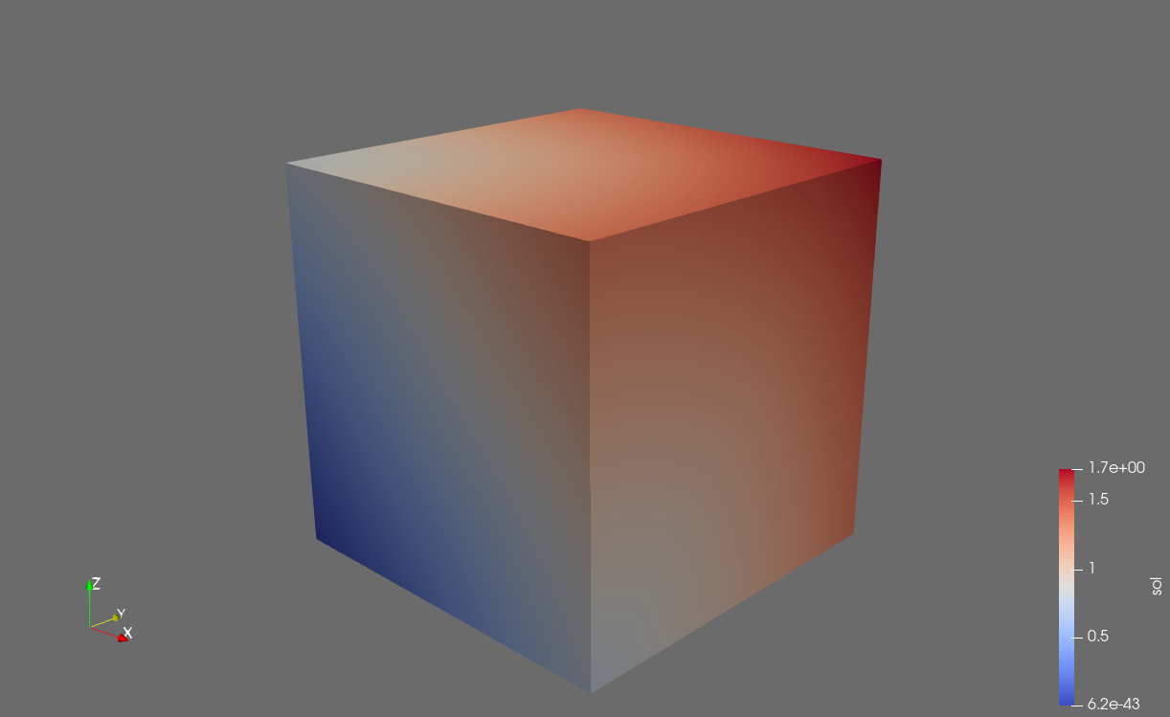
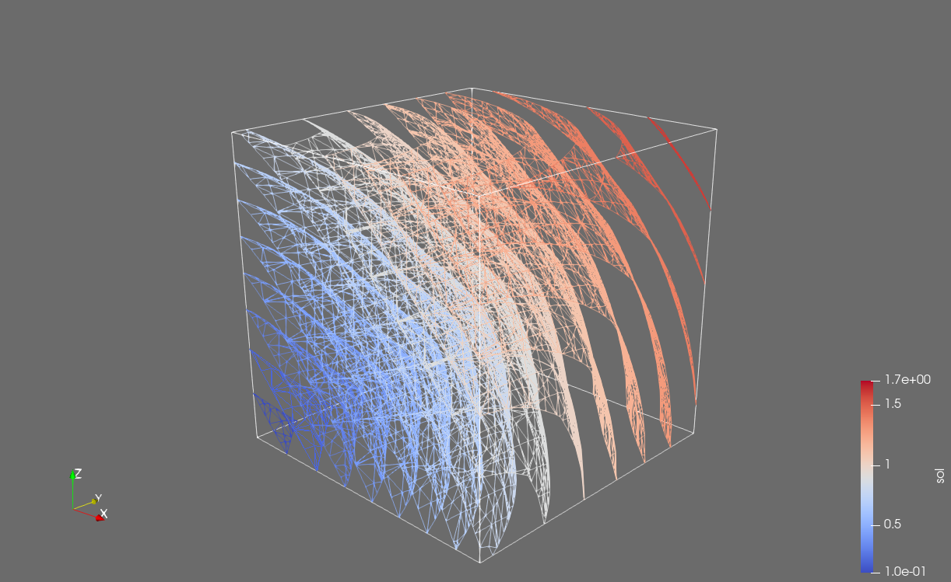
Results
Solution and contour plot for Dirichlet boundary conditions on one vertex of the domain

Slide 30
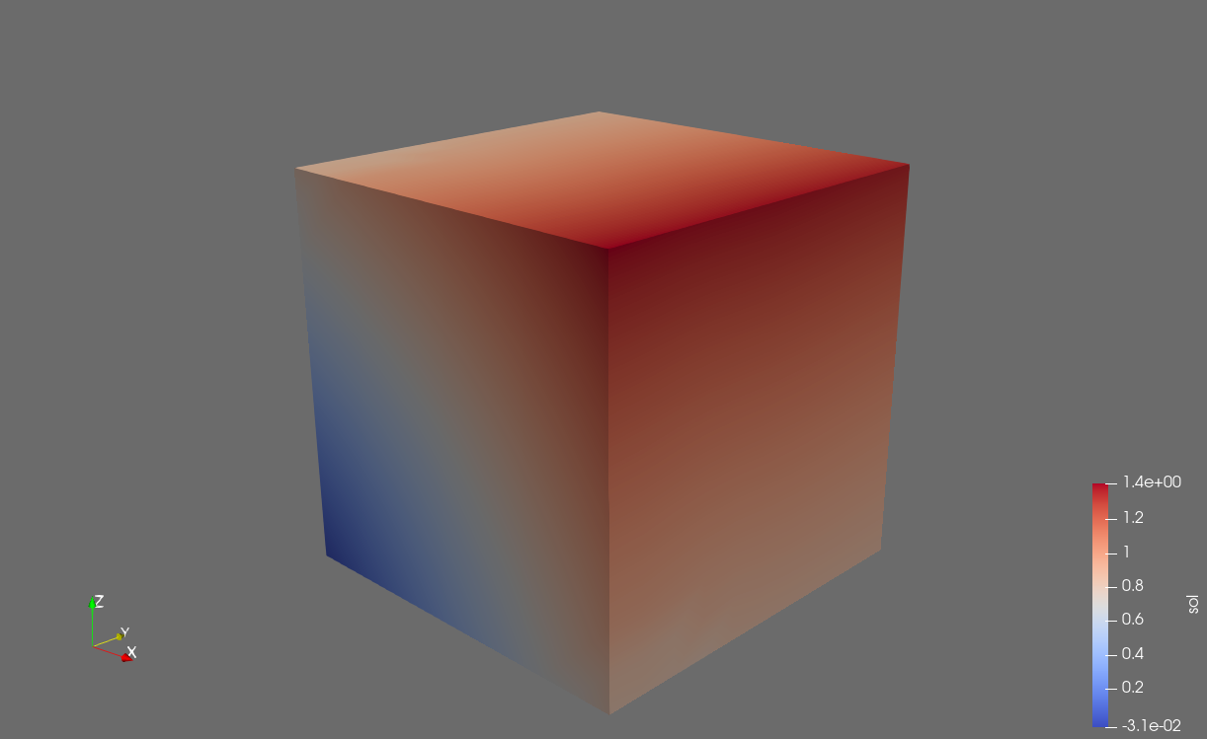
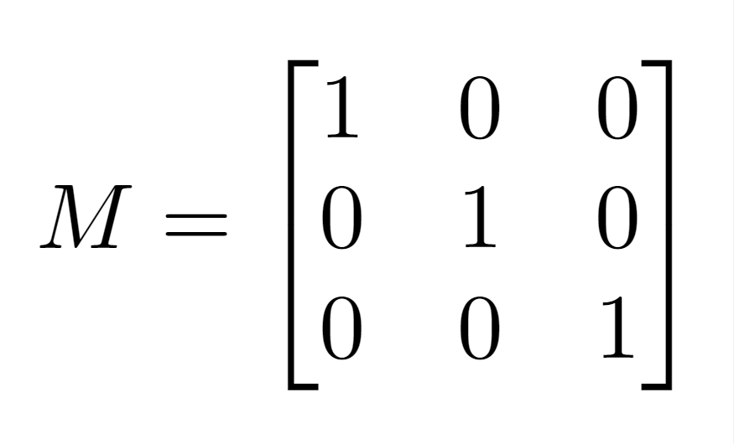
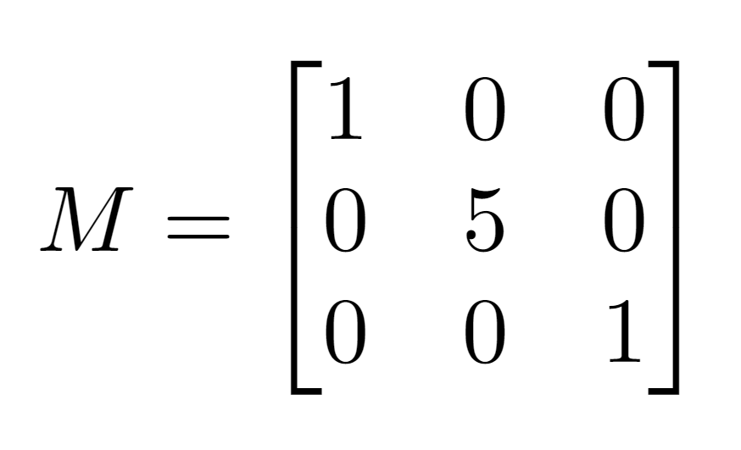
Results – Anisotropic solution
Isotropic medium
Anisotropic medium

Slide 31
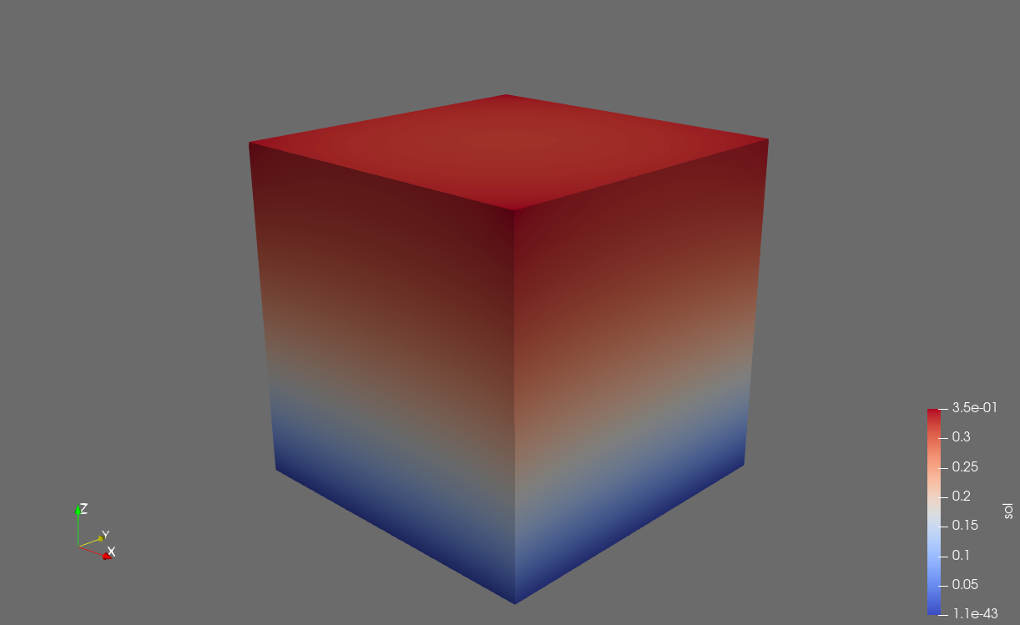
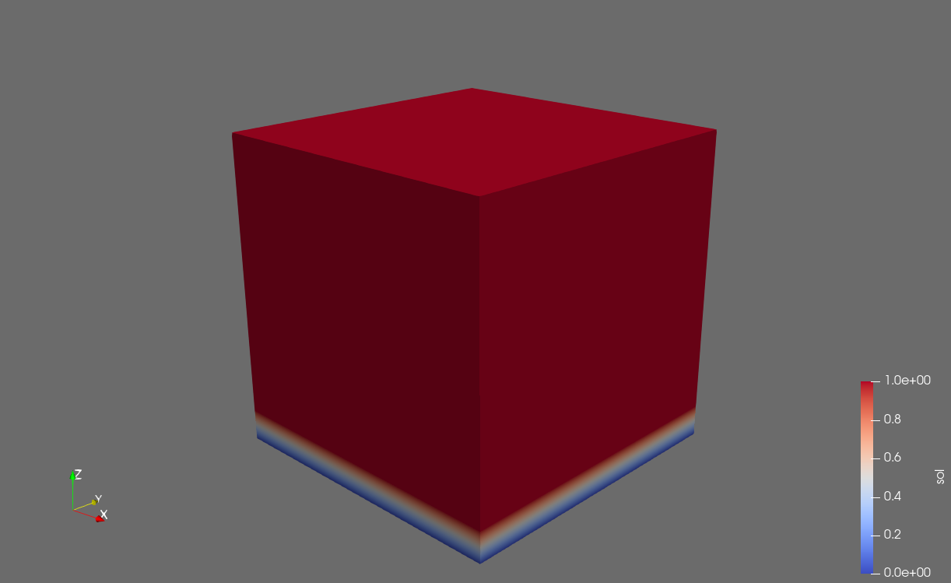
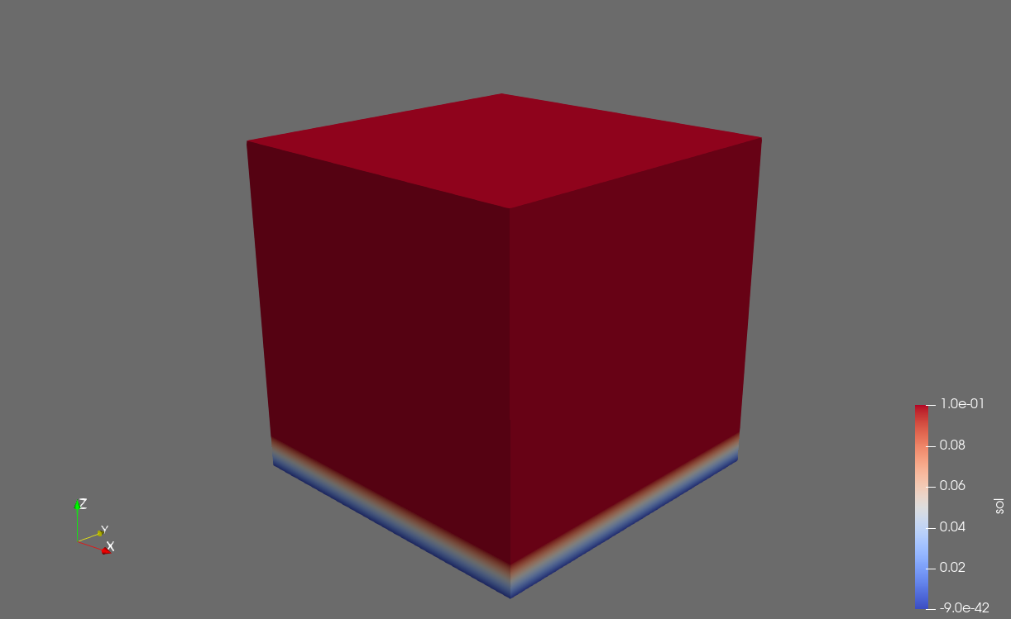
Results – Dependence on the initial solution
Initial solution
Solution with standard method

Slide 32
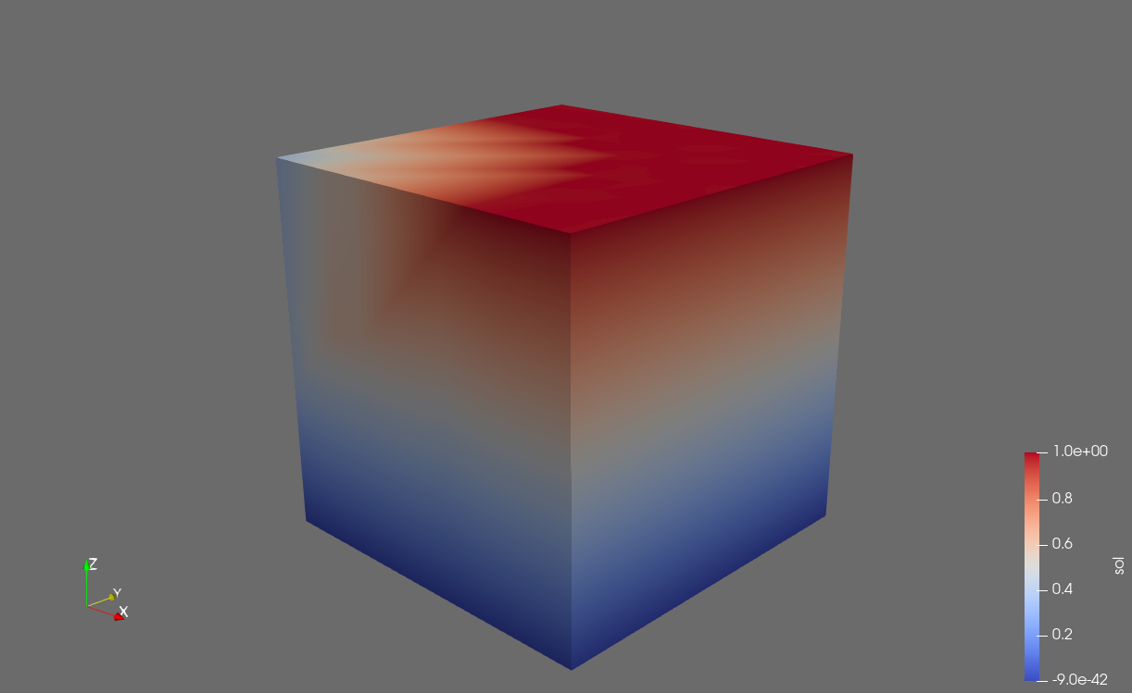
Results – Dependence on the initial solution
Initial solution
Solution with penalty method

Slide 33
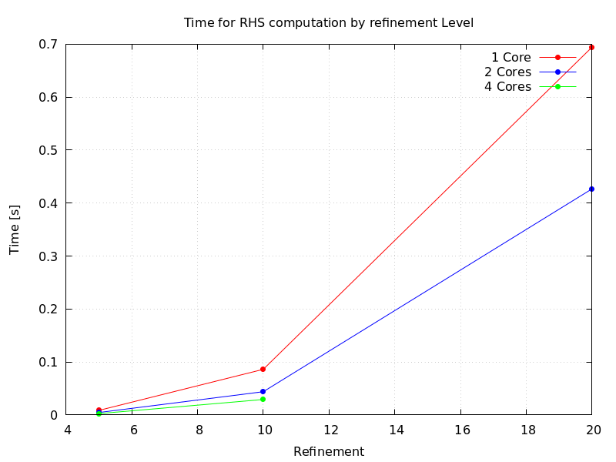
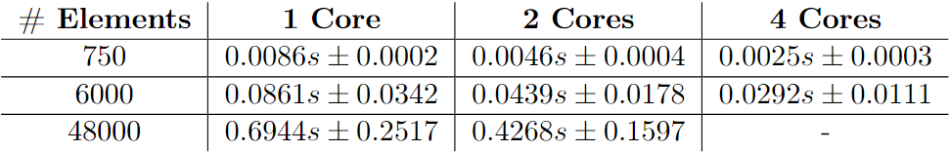
Results - Parallelization
Times [s] for computation of the right-hand side of the linear system at each iteration
Average $±$ std across iterations for one solution

